Slide 1


Image2Txt.Doc
Dean Pienica
Mhariadora Bocalbos

Slide 2

The Healthcare Challenges
1. Scheduling appointments with doctor is difficult - sometime it takes months before you get an appointment.

Slide 3

The Healthcare Challenges
2. Long waiting time before you get a doctor see you when you go to Urgent Care or the Emergency Room.

Slide 4
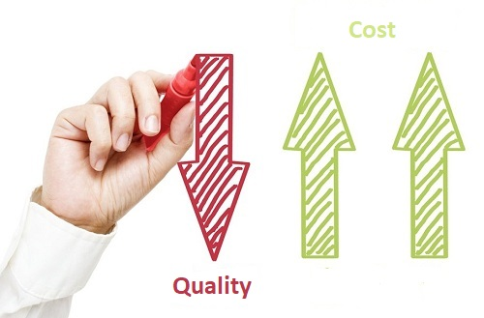
The Healthcare Challenges
3. Healthcare cost keeps on rising while quality of care is decreasing

Slide 5
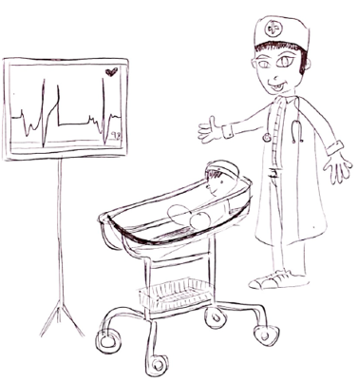
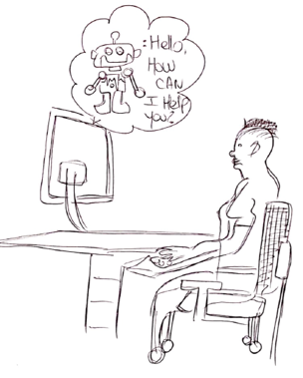
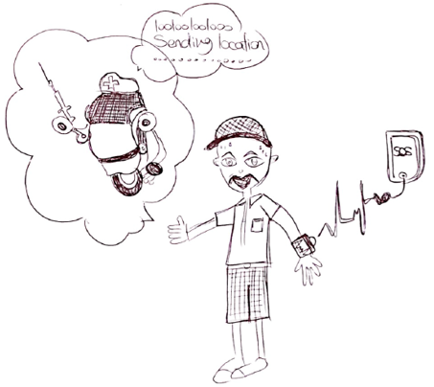
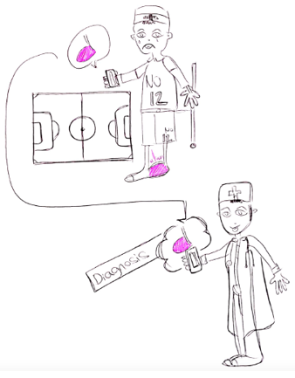
The Different Ideas
Make America Great Again
Hi, My Name is Rob!
Wise Device
Image2Txt.Doc

Slide 6

Sprint 1: Image2Txt.Doc

Slide 7



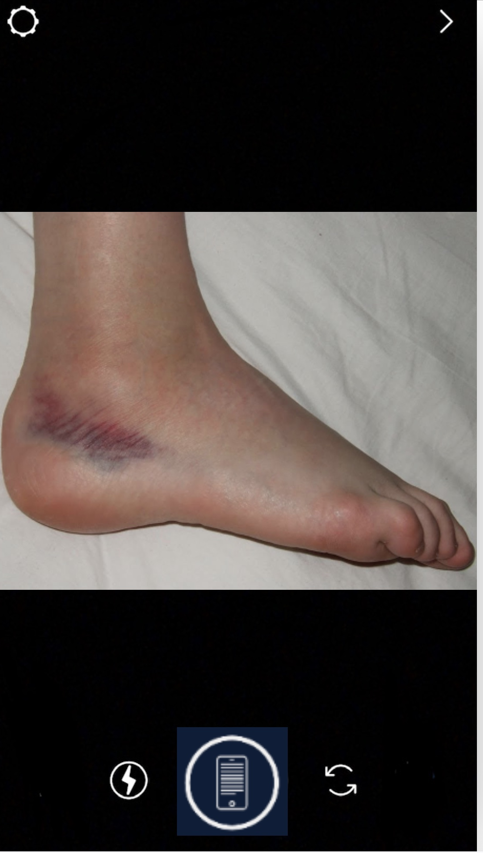


Sprint 1 Idea: Image2Txt.Doc

Slide 8

Sprint 1: Insights
“Saves a lot of time”
“Very convenient and easy to use”
Mostly can used by athletes and individuals who workout often
Outdoor enthusiasts can benefit from it.
Add-ons: Chatbot, live FaceTime & 360 degree photo.

Slide 9
Sprint 2

Slide 10
Technical Architecture
Flow Decision Engine
Conversational UI
Intent Recognition NLP Engine
User Database
Injury Image Detection
(Convolutional Neural Network/ CNN)
Image of Injury
Conversational UI
Treatment Database

Slide 11
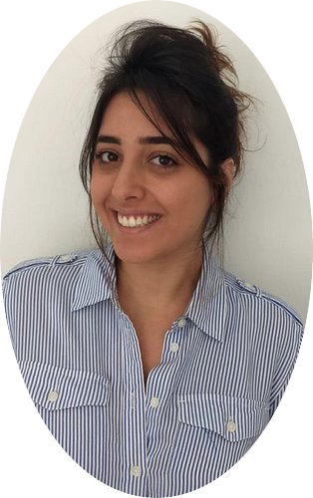


Tester Feedback
Michael Yomtobian
Full time Grad Student, 24
User/Possible Patient
Danielle Yohai
Real Estate Agent, 31
User/Possible Patient
Vyshakh Muchilote
DBA Student, 26
User/Possible Patient
“More questions with the chatbot regarding how you feel”
“Rather have a real doctor/human being checking your medical issue and not share a pic with a chatbot”
“This app can make an impact not just in the US but can benefit other countries as well.”
“Waiting a few days to see a doctor while this can be an emergency”
“Now, you don’t have to go to the hospital and wait for a long time.”

Slide 12

Successful!
Only 1/10 testers might not use the app in the future

Slide 13
